Slide 1
Intro to Deep learning
Session – 01: Introduction to PyTorch
Instructor: Diego Corona
The University of Manchester

Slide 2

Agenda
Introduction
Overview of PyTorch's tensor operations and automatic differentiation
The Mechanics of Deep Learning with PyTorch (?? mins)
Train a basic PyTorch model to understand the deep learning workflow.
Implement CNNs to enhance accuracy in computer vision tasks.
Apply data augmentation techniques to improve model generalisation.
Time Series Forecasting with CNNs
Break (?? mins)
Pre-trained Models and Recurrent Networks (?? mins)
Apply transfer learning to fine-tune models for personalised applications.
Train RNNs on sequential data, including a text autocompletion task
Break (?? mins)
Final Project: Object Multi-class Classification (?? mins)
Implement data generators in PyTorch to handle small datasets efficiently.
Use transfer learning and feature extraction for faster model training.
Final Review (?? mins)
Recap key learnings and answer questions.
Provide guidance on setting up a deep learning development environment.

Slide 3
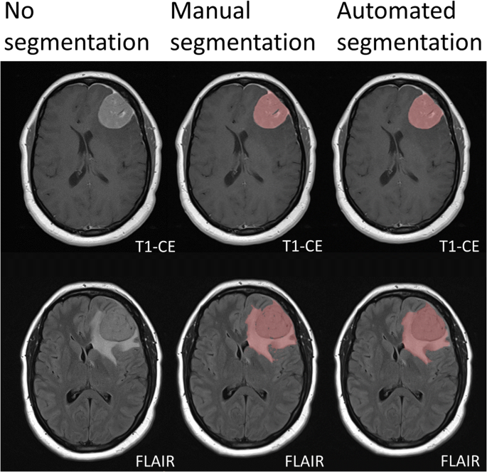
Learning from example

Slide 4
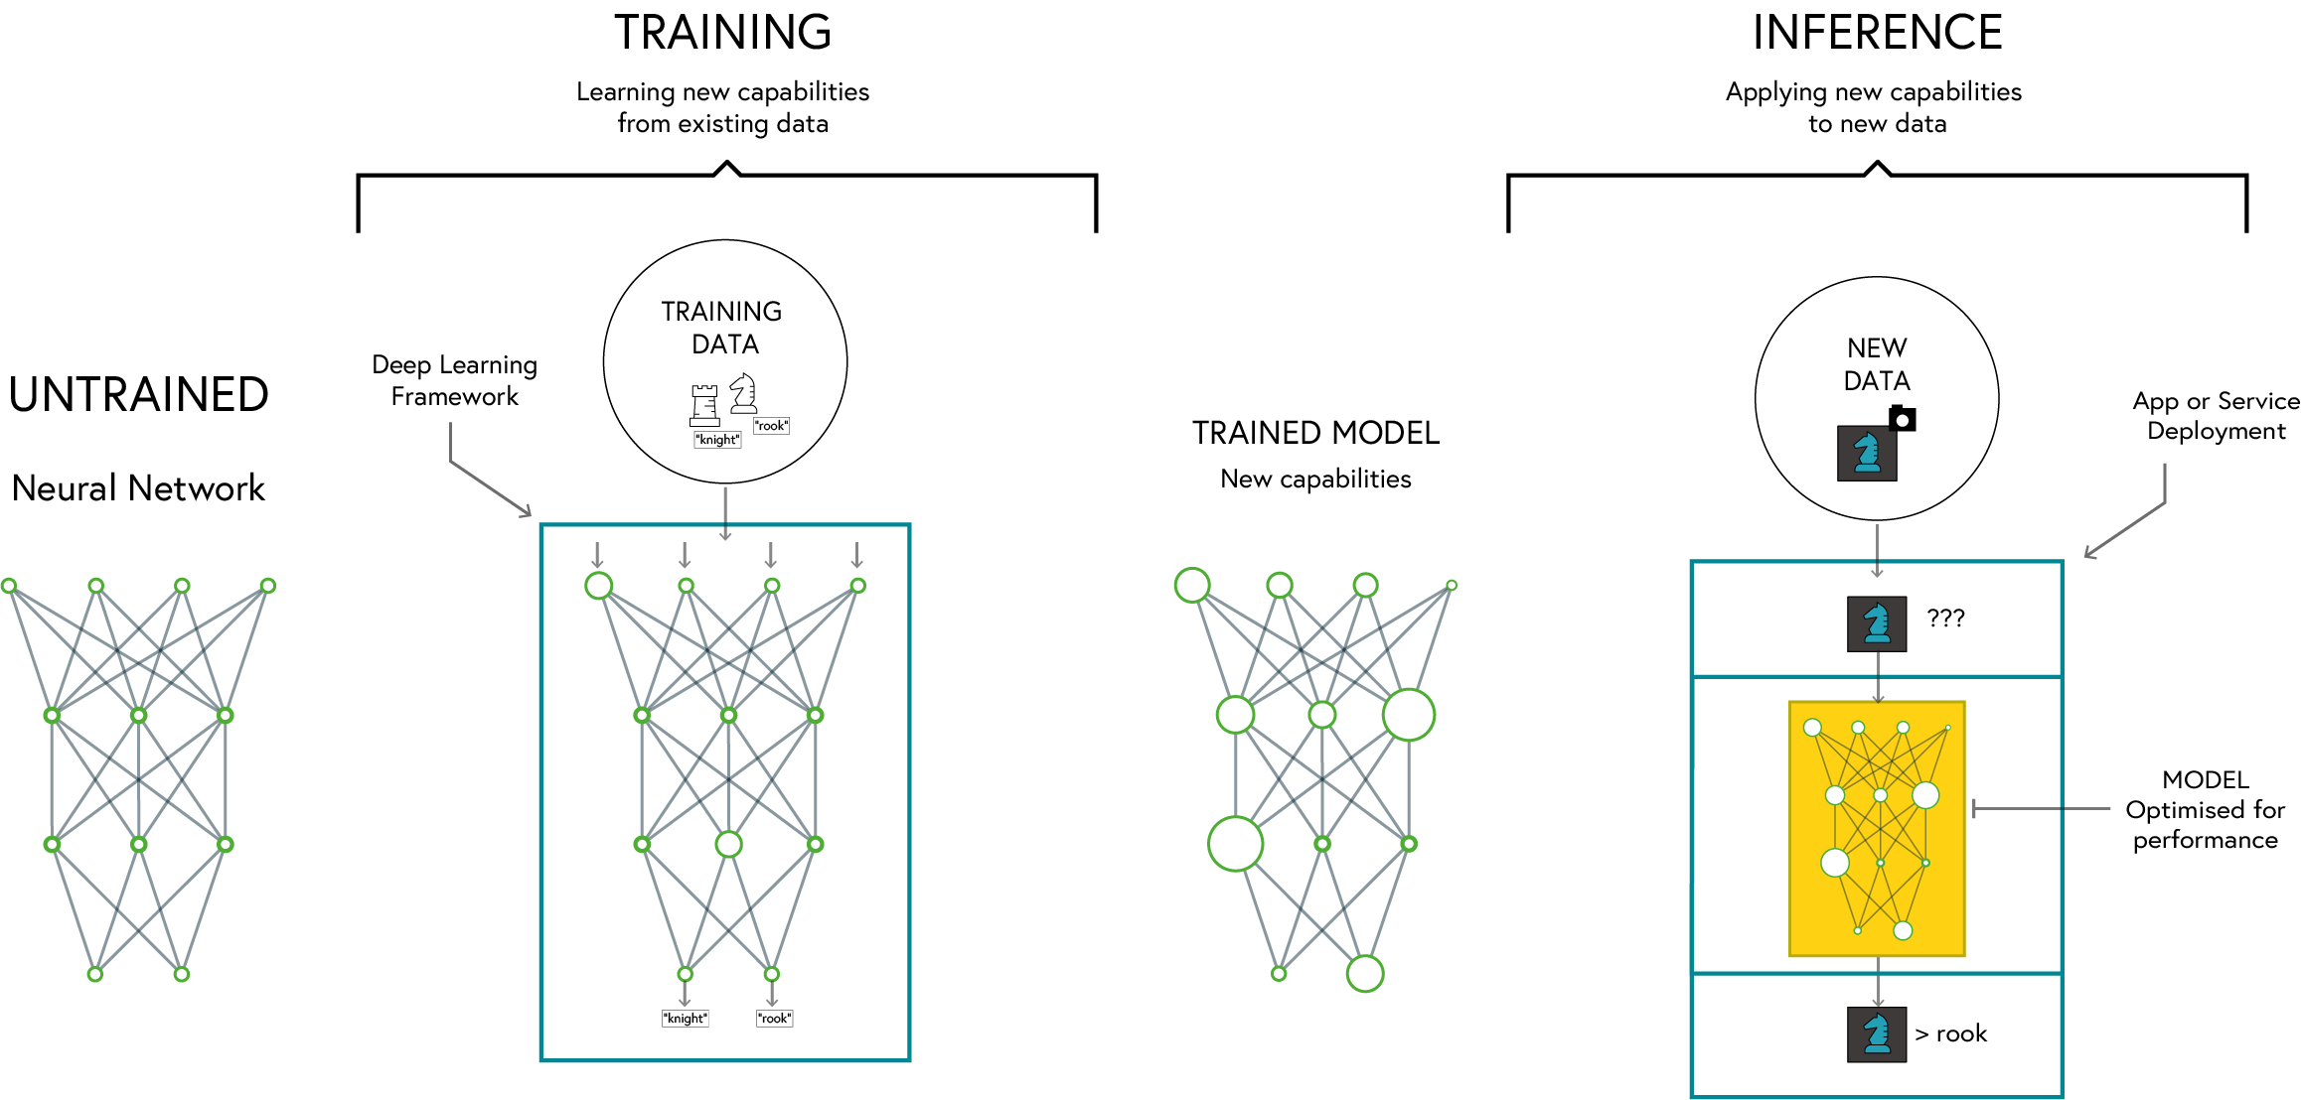
Deep learning

Slide 5

PyTorch
Dynamic Computation Graph: Easier debugging and flexible model building
Pythonic and Intuitive API: Seamless integration with Python libraries
Strong Research and Industry Adoption: Used by major companies and researchers
Excellent GPU Acceleration: Optimised for performance on GPUs and TPUs
https://pytorch.org

Slide 6
Why PyTorch
Feature | PyTorch | TensorFlow | Keras
Ease of Use | High (Pythonic, dynamic computation graph) | Moderate (Static graph by default, more setup) | Very High (High-level API)
Flexibility | High | Moderate | Low (abstracted API)
Performance | High | Very High (Optimized for deployment) | Moderate
Debugging | Easy (Eager execution) | Harder (Graph-based execution) | Easy
GPU Support | Excellent | Excellent | Good
Industry Use | Research, Prototyping | Production, Deployment | Rapid Prototyping

Slide 7
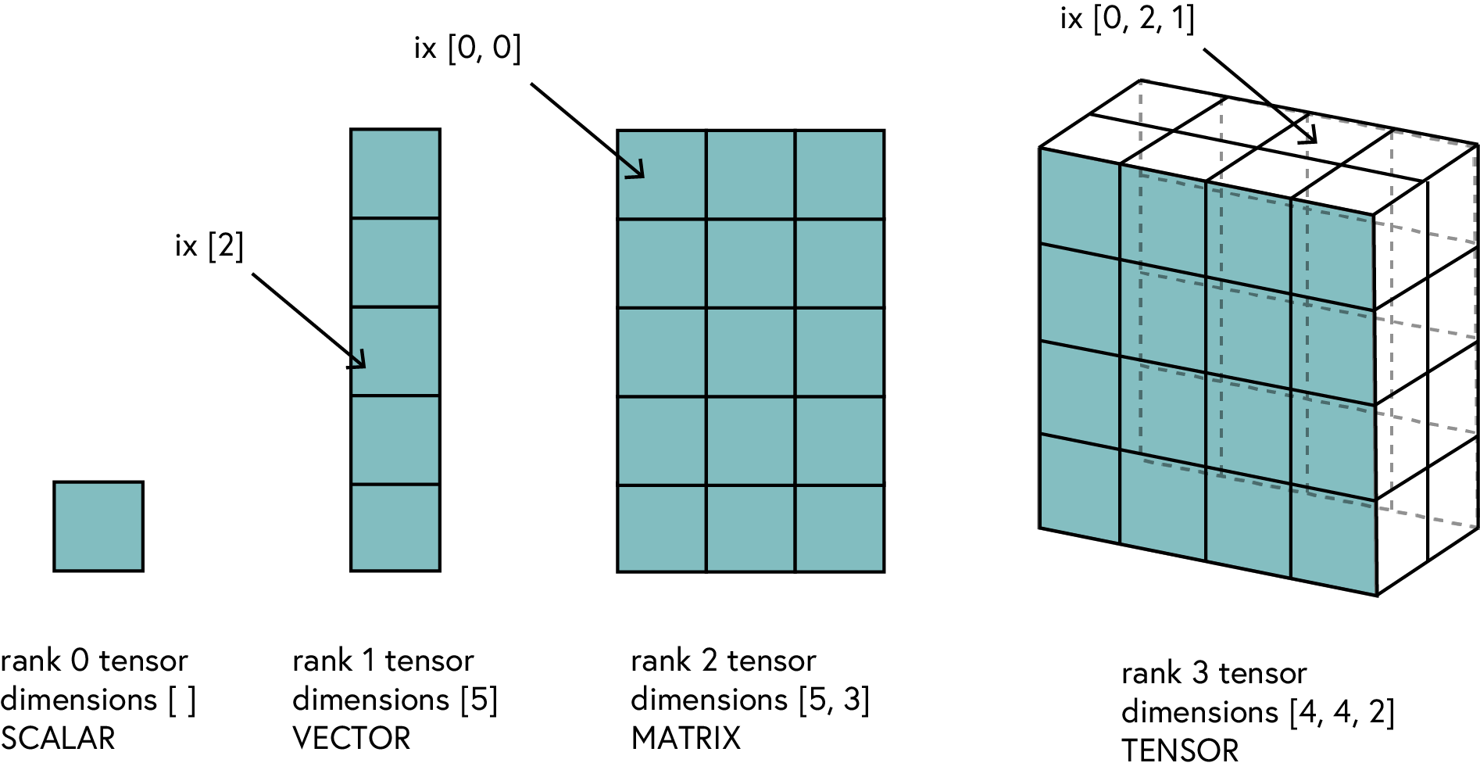
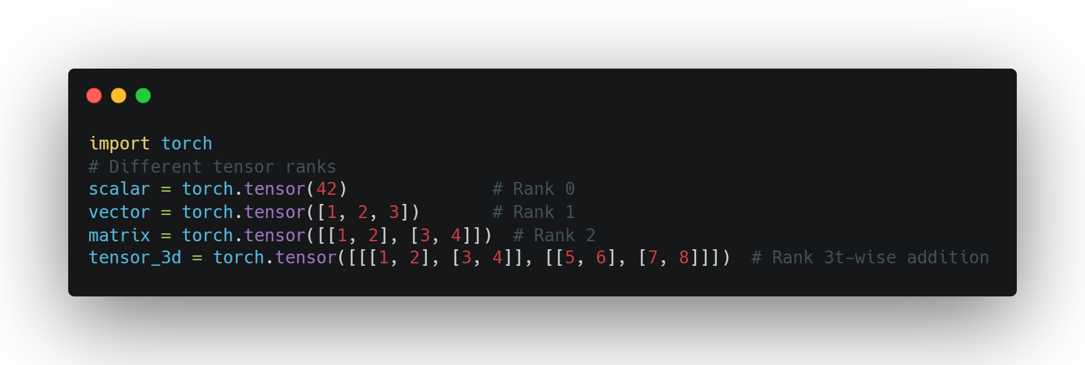
Tensors
Definition: A generalization of vectors and matrices to higher dimensions
Why Tensors?
Efficient representation of multi-dimensional data
Optimized for computation (CPU & GPU)

Slide 8
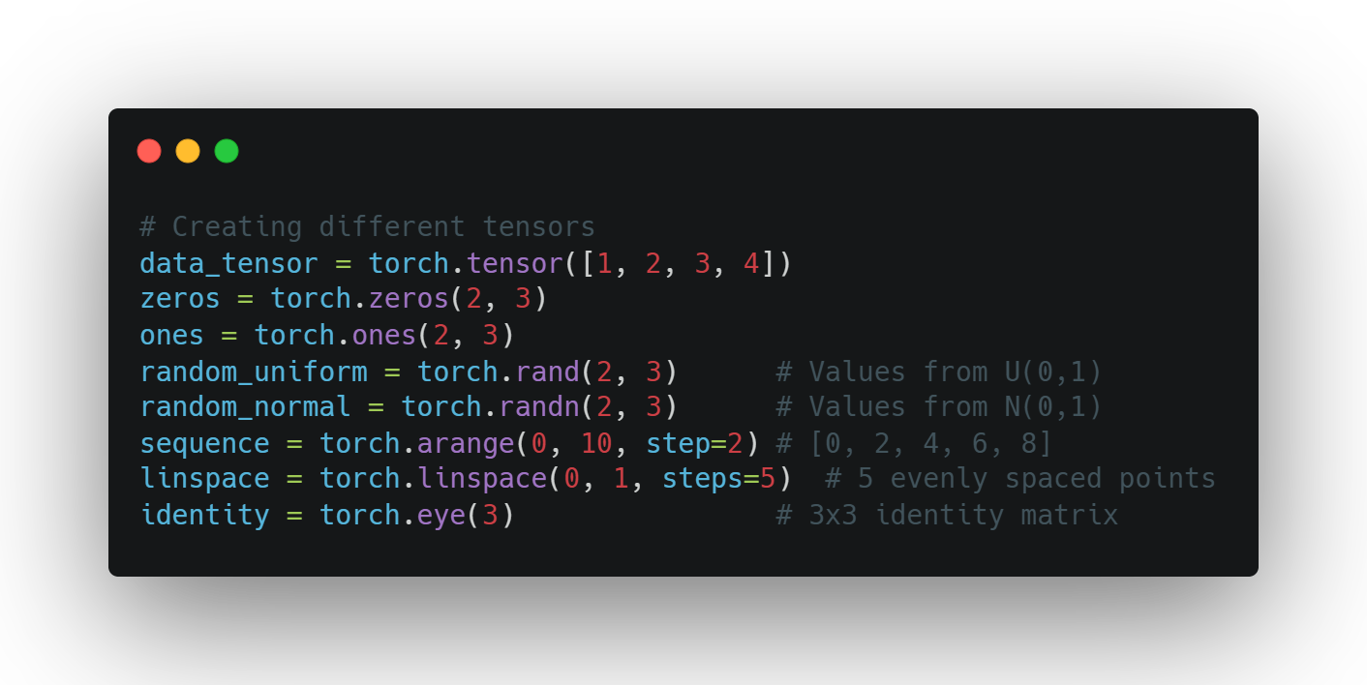
Creating Tensors
Basic Tensor Creation Methods
torch.tensor() - from existing data
torch.zeros(), torch.ones() - filled tensors
torch.rand(), torch.randn() - random tensors
torch.arange(), torch.linspace() - sequences
torch.eye() - identity matrices
Data types can be specified with dtype parameter

Slide 9
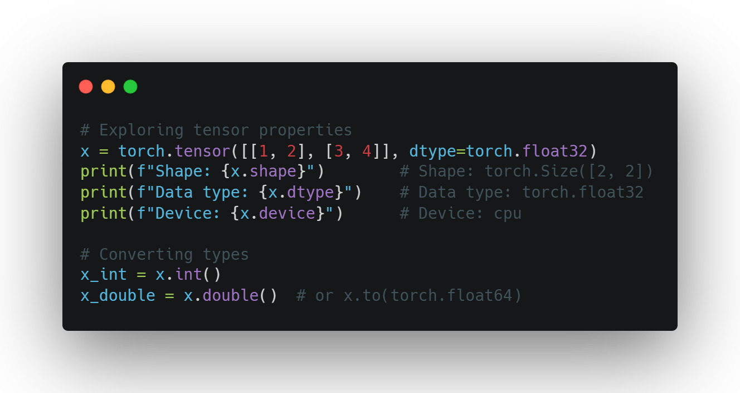
Tensor Properties
Working with Tensor Attributes
Shape: tensor.shape
Data type: tensor.dtype
Device: tensor.device
Accessing values: tensor.item() for scalars
Converting types: tensor.float(), tensor.int()

Slide 10
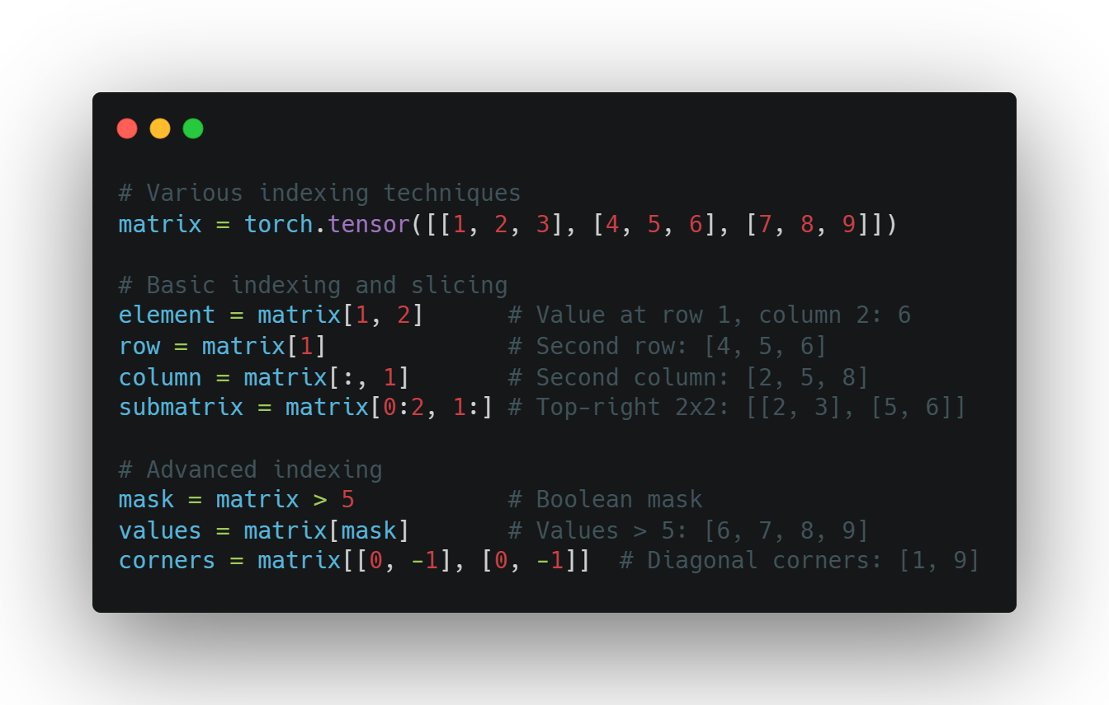
Tensor Indexing
Accessing Tensor Data
Basic indexing: tensor[i, j]
Slicing: tensor[1:3]
Advanced indexing techniques:
Boolean masks: tensor[tensor > 0]
Negative indexing: tensor[-1] (last element)
Using ellipsis: tensor[..., 0]

Slide 11
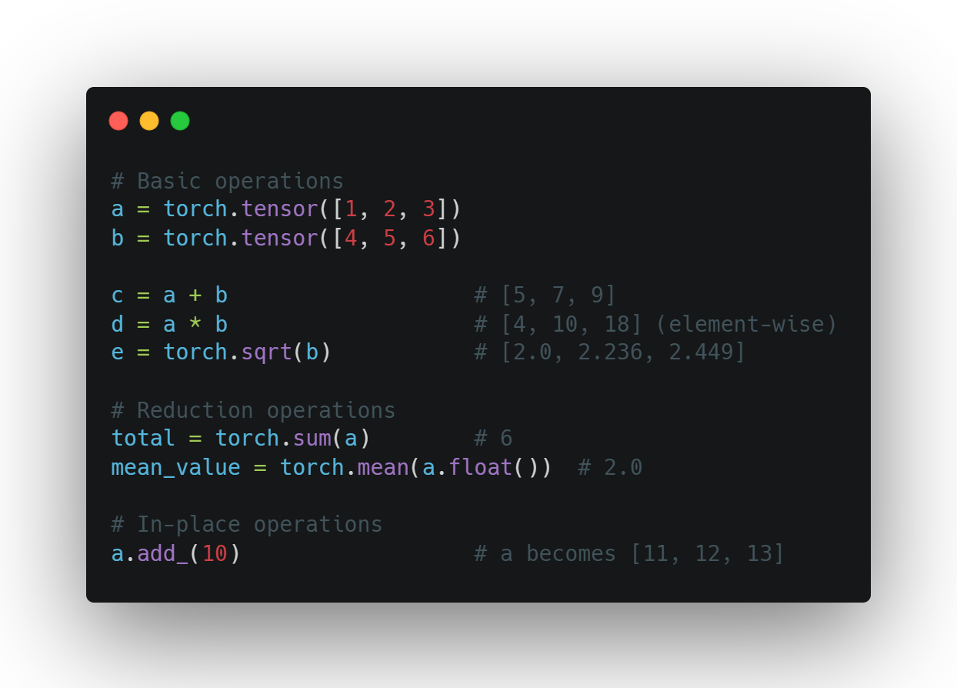
Basic Tensor Operations
Common Operations
Arithmetic: +, -, *, /
Element-wise operations: torch.sqrt(), torch.pow()
Reduction: torch.sum(), torch.mean()
Comparisons: >, <, ==
In-place operations: tensor.add_(1) (note the underscore)

Slide 12
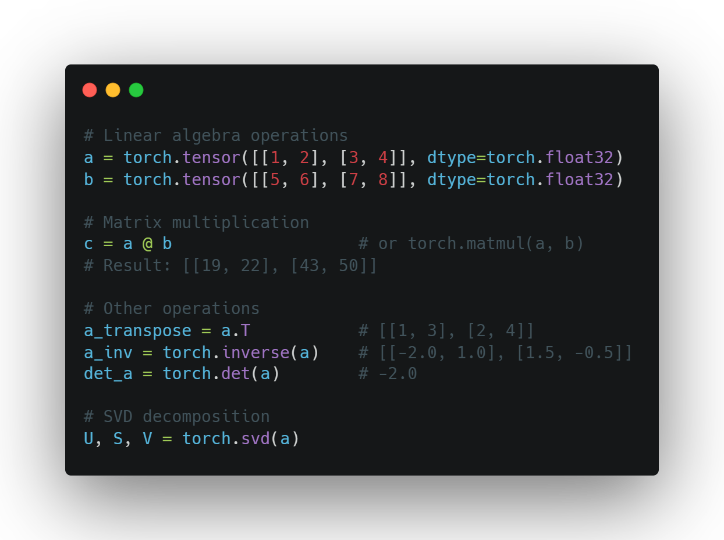
Matrix Operations
Linear Algebra with PyTorch
Matrix multiplication: @ or torch.matmul()
Transposition: .T or torch.transpose()
Inverse: torch.inverse()
Determinant: torch.det()
Eigenvalues: torch.eig()
SVD: torch.svd()

Slide 13
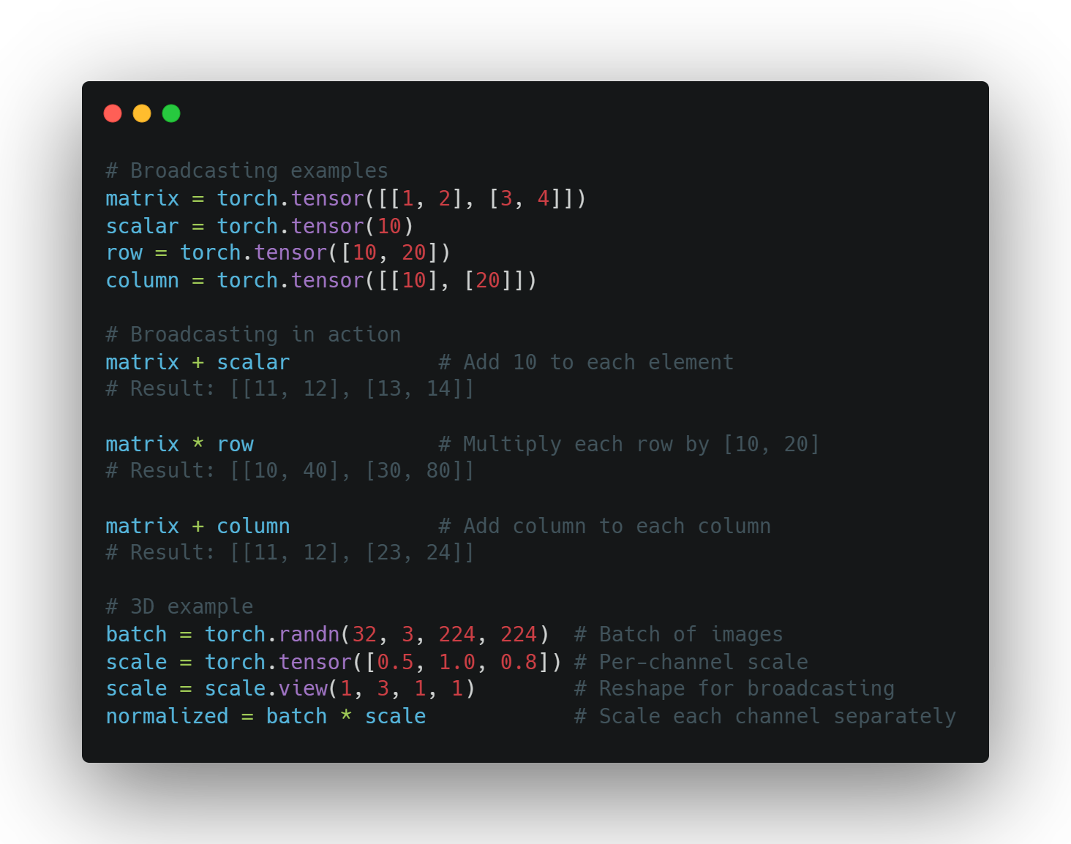
Broacasting
Working with Different Shapes
Automatic expansion of smaller tensors
Rules follow NumPy broadcasting
Eliminates need for explicit reshaping
Examples:
Add scalar to matrix
Multiply matrix by row/column vector
Scale batches of data
Powerful but requires understanding

Slide 14
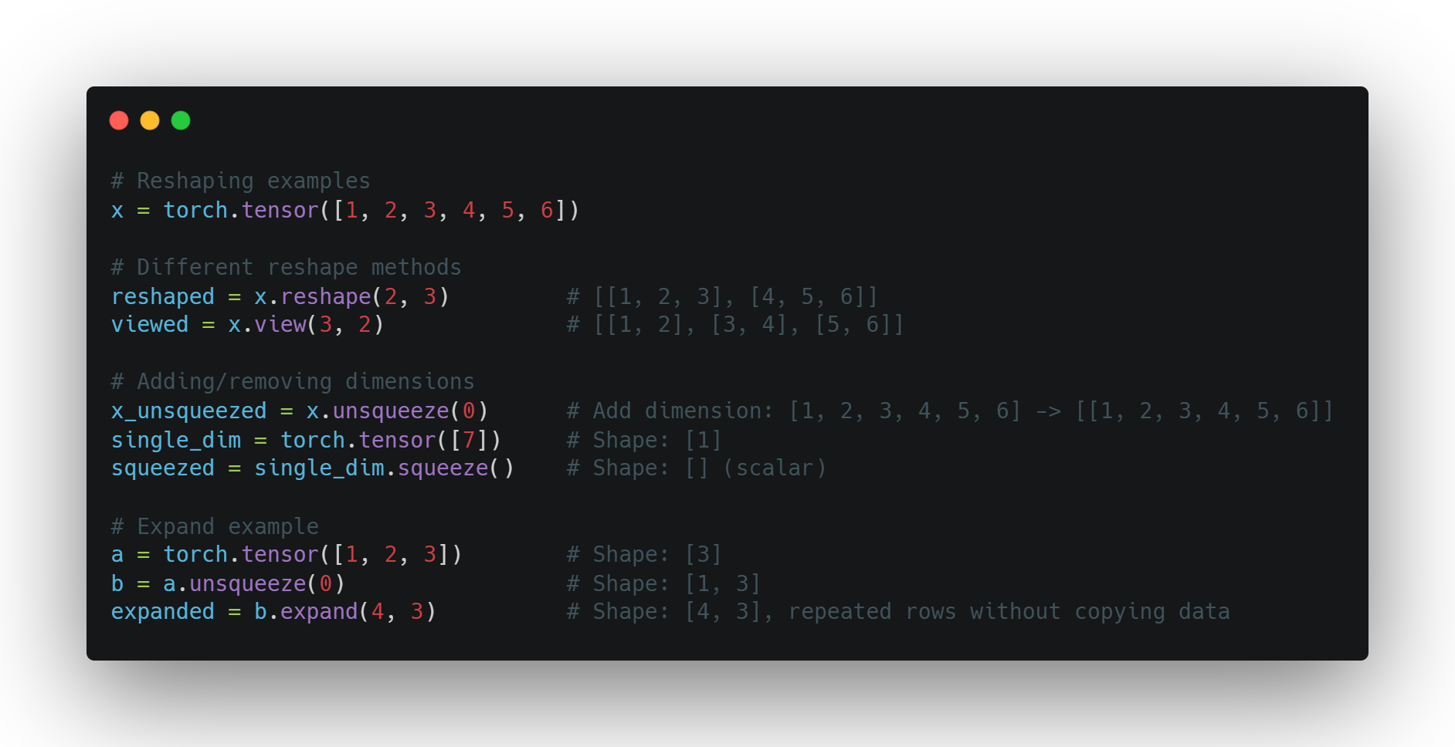
Reshaping
Changing Tensor Dimensions
reshape() - new shape, possibly new memory
view() - new shape, same memory (must be contiguous)
squeeze() - remove dimensions of size 1
unsqueeze() - add dimension of size 1
expand() - broadcast dimensions without copying

Slide 15
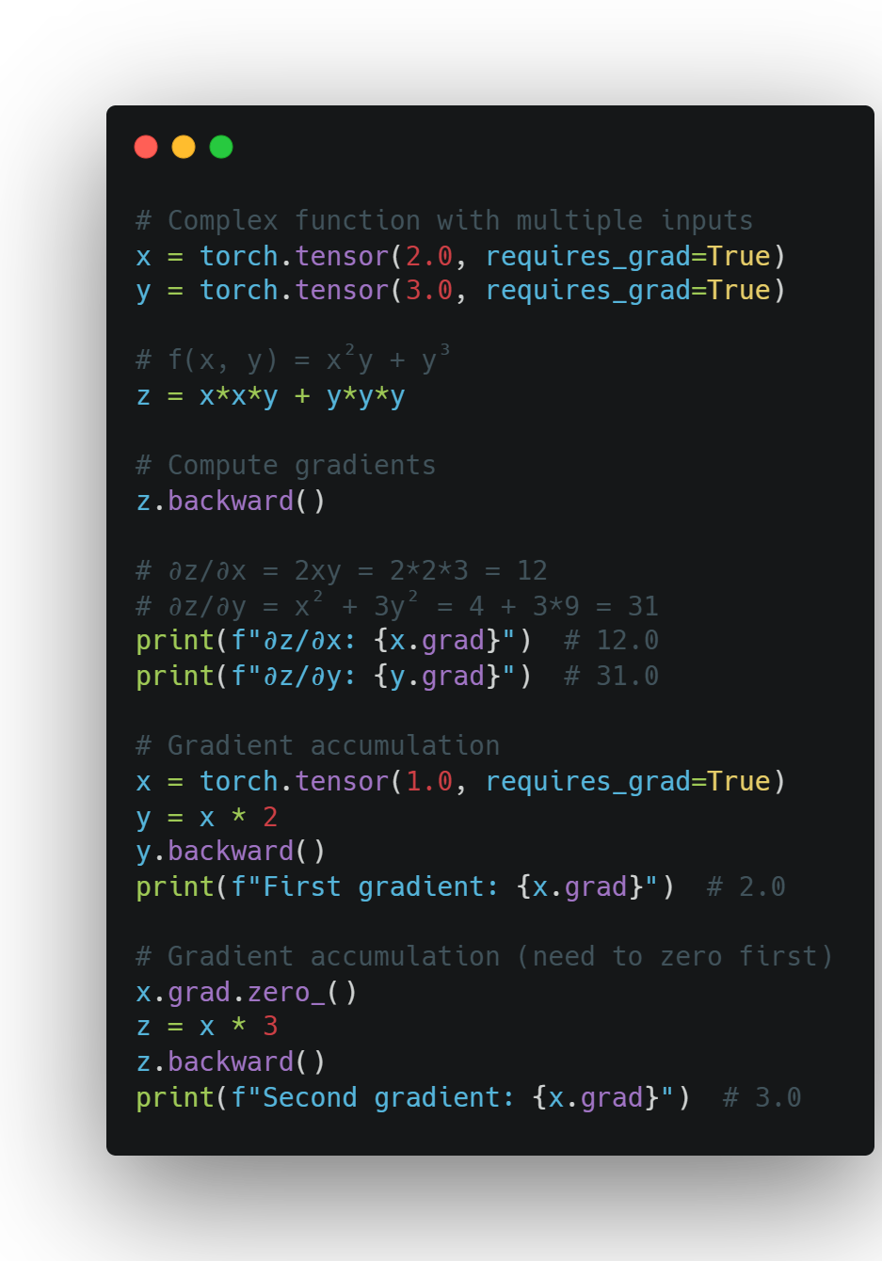
Using autograd
Computing Gradients
Enable tracking with requires_grad=True
Build computation graph through operations
Call backward() to compute gradients
Access gradients via tensor.grad

Slide 16
Using autograd
Computing Gradients
Enable tracking with requires_grad=True
Build computation graph through operations
Call backward() to compute gradients
Access gradients via tensor.grad

Slide 17
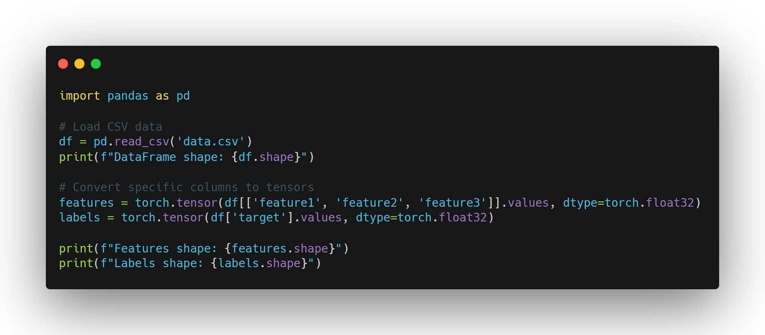
Loading data
From Raw Data to Tensors
Common data sources: CSV, images, text
Using pandas to load structured data
Converting to tensors:
df = pd.read_csv('data.csv')
tensor = torch.tensor(df.values)
DataFrames as an intermediate representation

Slide 18
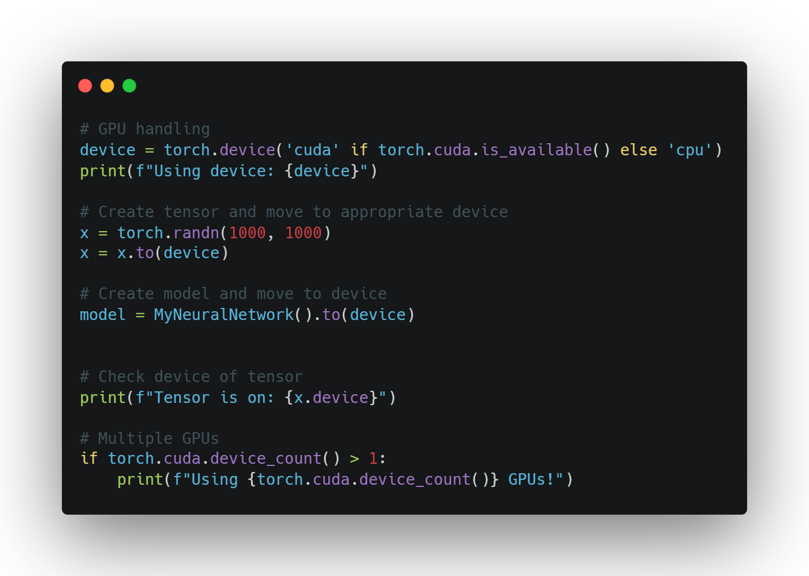
Using the GPU
Leveraging Hardware
Check availability: torch.cuda.is_available()
Select device: device = torch.device('cuda')
Move tensors to device: tensor = tensor.to(device)
When to use GPU:
Large tensors/datasets
Computationally expensive operations
Deep learning model training
Keep all tensors on same device for efficiency

Slide 19

Best Practices
Tips for Effective PyTorch
Match tensor types before operations
Understand broadcasting rules
Use in-place operations when appropriate
Keep track of your tensor devices
Leverage PyTorch's documentation
Experiment and debug with small examples first

